Slide 1






Handwriting Digital Recognition
Name:Huijun Hong ID:U62543343

Slide 2
Introduction
Computers receive and understand the readable numbers recognized from paper documents, photographs, or other sources.
Decrease labor cost
Recognize numbers in different scenes

Slide 3
Algorithm
Use KNN and SVM to make classified predictions in handwriting dataset MNIST.
MNIST include 60000 training samples and 10000 test samples, scale down to 1/10: 6000 training samples and 1000 test samples.

Slide 4
KNN Design
Use fit() to save training data for calculating.
Construct a KNN classifier and pass training data set into
Predict the results from the test set
Compare with the results of the test set
Get the KNN classifier accuracy

Slide 5
SVM Design
Use train_test_split functions to divide training and test sets randomly
Choose SVC for our classifier
Use fit() in training data and then save data for calculating
Use score() to evaluate the training and test accuracy after learning
Get the SVM classifier accuracy

Slide 6
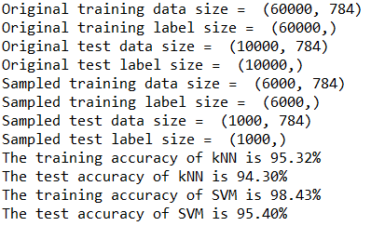
Result
SVM training and test accuracy are both better than KNN
KNN just find the k values in the training dataset that are closest to the sample points, it makes the result can be very volatile.

Slide 7
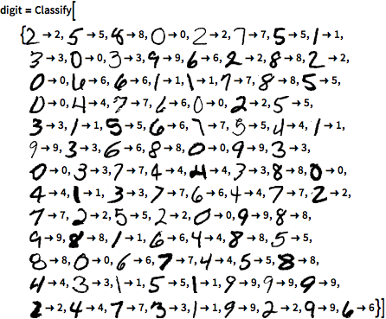
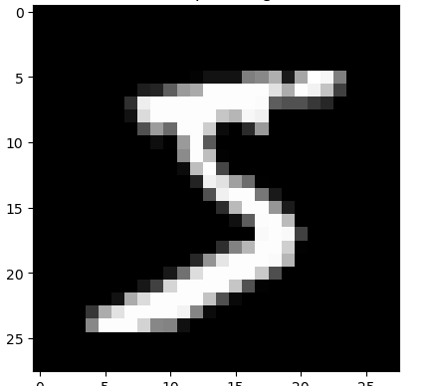
Thank you for Watching

